Slide 1
Diagnostic Error Reduction: Tackling Follow-up System Failures
Missy Lindow, MBA
Director of Operations
Lakewood health System

Slide 2
Partnerships
Notes:
RPAP student, we have to get out of our silos. Rural health care organizations often miss out on research opportunities… despite the incredible investment of systems and communities.

Slide 3
Funding

Slide 4
Diagnostic Error: Defined
Diagnostic error is the failure to establish an accurate and timely explanation of the patient’s health problem and communicate that to the patient.
(National Academies of Sciences, Engineering, and Medicine et al., 2015)
Notes:
The working explanation of diagnostic error in this study

Slide 5
Overview:
This research makes recommendations to decrease diagnostic error by co-designing the process of diagnostic test management in the rural health care system.
The study will identify the optimal team (patients, families, clinicians, and health care systems) and their roles in managing diagnostic test follow-up in high-risk transitions of care, focusing on discharge from a rural emergency department.

Slide 6
Need for Study
The prevalence of diagnostic error in current research indicates the likelihood of every American experiencing a minimum of one diagnostic error in their lifetime (Jones & Magee, 2018).
Diagnostic error has been identified as the primary cause of medical malpractice claims (Saber Tehrani et al., 2013).
An estimated 25% of diagnosis-related malpractice claims were related to follow-up system failures (Gandhi, 2005).
Compliance with recommended follow-up by Emergency Department patients in the U.S. is frequently poor and has been estimated to be 26-56% depending on the population; however, the scope of the problem in rural health care systems is not well described (Kyriacou et al., 2005).

Slide 7
Design
Short Term Follow-Up
Medium Term Follow-Up
Long Term Follow-Up
Blood and Urine Cultures
Abnormal Creatine
Pulmonary Nodule
Adrenal Nodule

Slide 8
Project Timeline
June 2019: Grant Awarded
October 2019: Current State Process Mapping
March 2020: Chart Reviews & Community Surveys Completed
May 2021: Presented at the Iowa Healthcare Collaborative + Society to Improve Diagnosis in Medicine
March 2022: Restarted Grant Work
July 2022: Future State Mapping
Q1 2023: Launch NEW Workflows

Slide 9
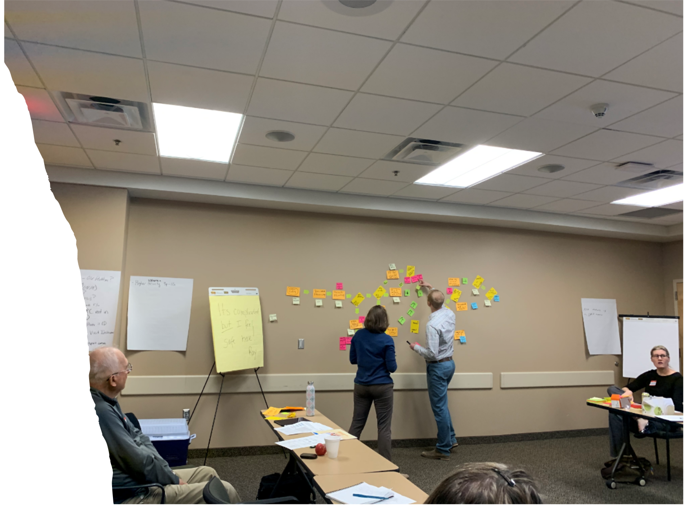
Current State Process Mapping

Slide 10
Current State: Chest CT Workflow

Slide 11
Current State Process Map: Chest X-Ray

Slide 12
Current State Process Map: Cultures

Slide 13
Community Engagement
Notes:
Patient Partner Training - MAPS
Patient Family Advisory Council (PFAC)
VOICE
Food Pharmacy
Medical Hme Advisory Council
Trident Foods
Service Groups

Slide 14
Patient Communication Preferences

Slide 15
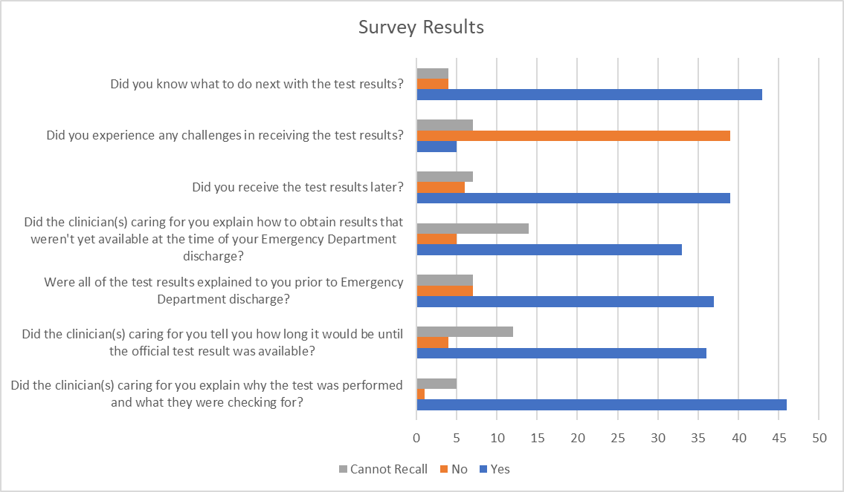
Emergency Department: Test Results
Notes:
No news is good news.

Slide 16
Chart Reviews
Notes:
The medical records of patients presenting to the emergency department with an incidental finding identified by chest radiology were reviewed to generate baseline follow-up system failure data. The most common secondary finding were pulmonary nodules, possible masses, thyroid abnormalities, and intrabdominal findings such as an adrenal nodule.

Slide 17
Chest Radiography
38.5% of patients were lost to follow-up
We missed addressing the incidental finding 45% of the time
Notes:
Overall, there were 39 potentially actionable findings in the data set. Of these, emergency department clinicians discussed 36% in the Emergency Department note, and the clinician documented the need for follow-up 31% of the time. The finding (21%) and the follow-up (31%) were mentioned uncommonly in the patient instructions. Overall, 62% of these patients had a follow-up visit with primary care; of these, primary care clinicians addressed the finding 63% of the time.

Slide 18
What we learned:
Variation in follow-up systems evident
Established workflows are not highly reliable in reducing the risk of follow-up system failure
Problems were identified at various stages of the diagnostic process
recognizing secondary findings in the emergency department
communicating with the patient at the time of the emergency department visit
Identified risk factors for being lost to follow-up
Most hospital follow-up systems in health care systems are designed around the providers, not the patients. This contributes to the follow-up system failures and highlights the importance of co-designing a follow-up system with patients and community members.

Slide 19
Future State Process Mapping

Slide 20
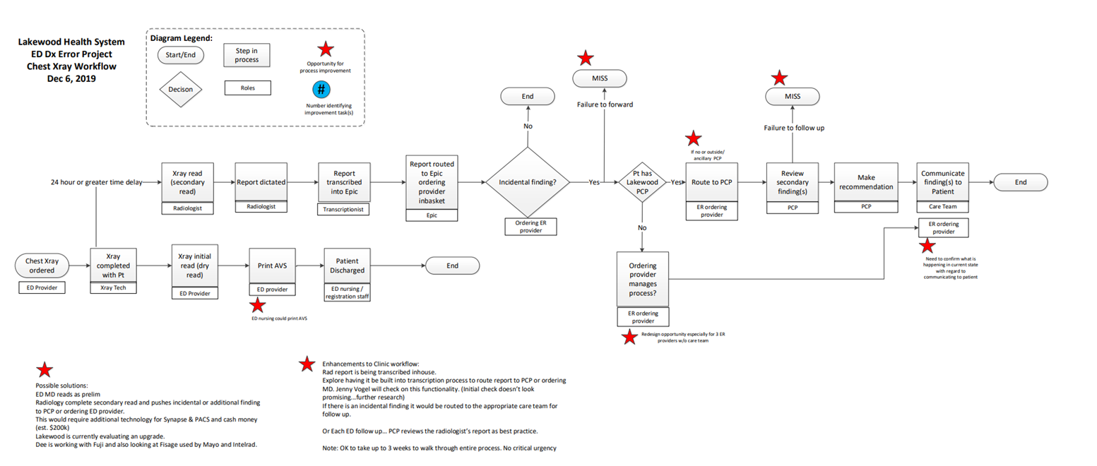
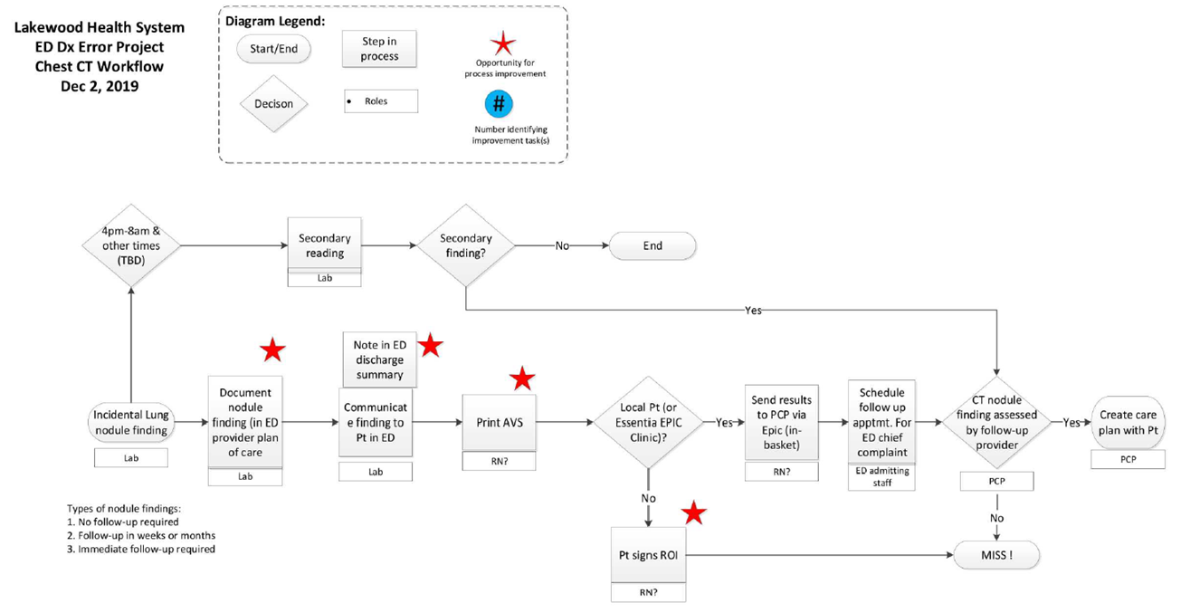
Future State: Chest X-Ray + Chest CT

Slide 21
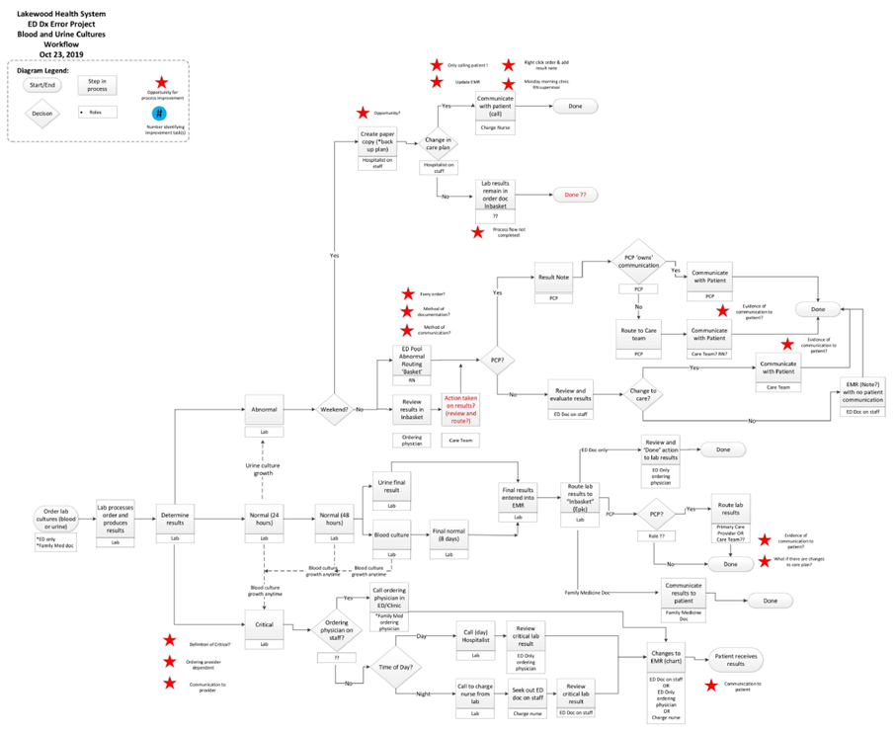
Future State: Cultures

Slide 22
Feedback:
“We turned a disaster into something I can understand.” – Leader
“Now the work starts-taking our vision and putting it into action”- Leader
“Having time and the key people in the room was key”- staff manager
“Fueling collaboration in this way is something we need to do more of”- Administration
“As an outsider, it was great to see that nobody was embedded into what is currently”-Researcher/Doctor
“Staff did a phenomenal job advocating for other teams that weren’t in the room”- Leader
“This is one of the best process mapping processes I have been part of. I loved the collaboration and honesty. It was facilitated fabulously”- Patient Partner
“This totally filled my bucket. Patients provided us with incredible input- it is so important to have them in the room. Each patient added value” Administration
“My favorite part was see the messy cultures chart transform into an actual flow chart that was easy to follow”- Patient Partner
“This can be a model for future work”- Doctor

Slide 23
Next Steps: Implementation
ED Admitting Team trained to:
Schedule clinic follow-up appointments
MyChart enrollment
Release of Information
Clinical Informatics to finalize result pools (ED)
Work with the Business Intelligence Team to create automated report for normal cultures
Education of staff
Development of lung nodule clinic to support primary care

Slide 24
Next Steps: Managing Resistance & Monitoring Results
Create a clear understanding of the need for change
Quickly identify and address obstacles to hardwiring the improved workflows
Measure the success of decreasing diagnostic error through redesigning diagnostic test management - vital to ensuring the process’s long-term viability
Collect and analyze data to drive future decisions and shared learnings

Slide 25
Shared Learnings
Process Improvement in Rural Health Care:
Decreasing Diagnostic Follow-Up System Failures
Melissa B. Lindow
August 2022

